Slide 1
Project Title -
Student Name Yashika Upadhyay
College Name-Maharishi University of information technology
AICTE STU ID -STU6a6ba429d7c231785439273

Slide 2
PROBLEM STATEMENT
(Agricultural activities are influenced by seasonal variations in environmental conditions, farming practices, resource availability and market conditions. As a result, agricultural performance may differ from one season to another. However, raw agricultural data does not clearly explain how agricultural performance changes across seasons or what patterns can be observed in different seasonal conditions. The problem is to analyze the given agricultural dataset and investigate seasonal differences in agricultural performance by identifying meaningful patterns, trends, relationships and variations within the available data.

Slide 3
Project Description
Seasonal Agriculture Performance Analysis is a data-driven project that analyzes agricultural performance across different seasons, crops, geographical areas, environmental conditions, resource usage, irrigation methods, and economic factors.
The project uses Python, Pandas, NumPy, Matplotlib, Seaborn, and SciPy to clean and analyze the agricultural dataset. The analysis compares seasonal yield, production, water efficiency, disease/pest risk, and profitability. Correlation analysis and the Kruskal-Wallis statistical test are also used to identify meaningful relationships and differences.
The objective is to transform raw agricultural data into clear visual insights and data-driven findings that can support better understanding of seasonal agricultural performance and planning.

Slide 4
WHO ARE THE END USERS
For your Seasonal Agriculture Performance Analysis project, the end users can be:
Farmers – to understand seasonal crop performance and resource usage.
Agricultural Departments – to support agricultural planning and decision-making.
Agricultural Analysts & Researchers – to study seasonal trends and relationships.
Agribusiness & Agri-Companies – to evaluate crop, production, and economic performance.
Policy Makers – to support data-driven agricultural policies and planning.

Slide 5
Technology Used
Python – Main programming language for data analysis
Pandas – Data cleaning, processing, and analysis
NumPy – Numerical calculations
Matplotlib – Data visualization and charts
Seaborn – Statistical graphs and heatmaps
SciPy – Statistical testing, including the Kruskal-Wallis test
Google Colab – Development and execution environment
GitHub – Project code, dataset, and notebook repository

Slide 6
RESULTS
Seasonal Performance: Kharif showed the highest average yield (5.64 tonnes/ha) compared with Rabi (5.08) and Zaid (4.67).
Economic Performance: Kharif recorded the highest average profit (₹178,915), while Zaid showed an average loss (−₹24,805).
Water Efficiency: Kharif had the highest average water efficiency (5.89 tonnes/1000 m³).
Disease/Pest Risk: Kharif had the highest average risk (54.47%), followed by Rabi (40.48%) and Zaid (38.22%).
Crop Analysis: Crop performance varied across seasons, with Sugarcane having the highest yield values in the dataset
.
Statistical Analysis: The Kruskal-Wallis test showed a statistically significant difference in yield distributions across seasons (p < 0.05).

Slide 7
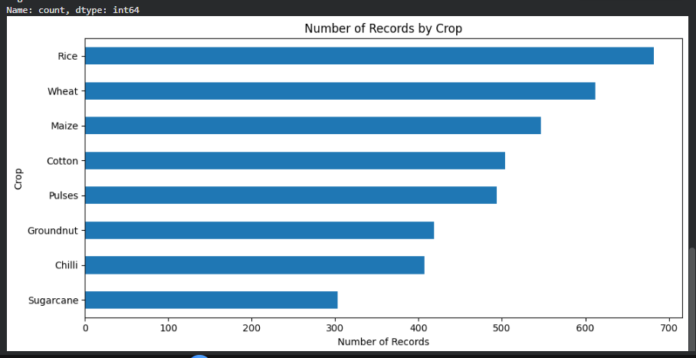
GRAPH 1

Slide 8
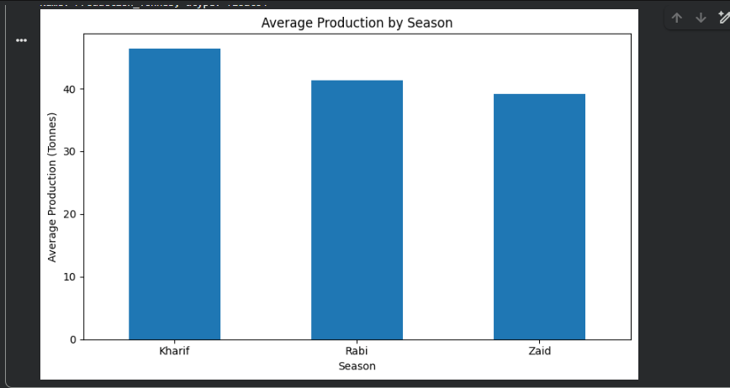
GRAPH 2

Slide 9
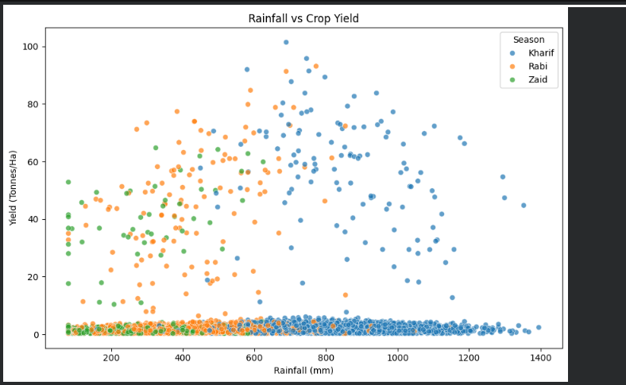
GRAPH 3

Slide 10
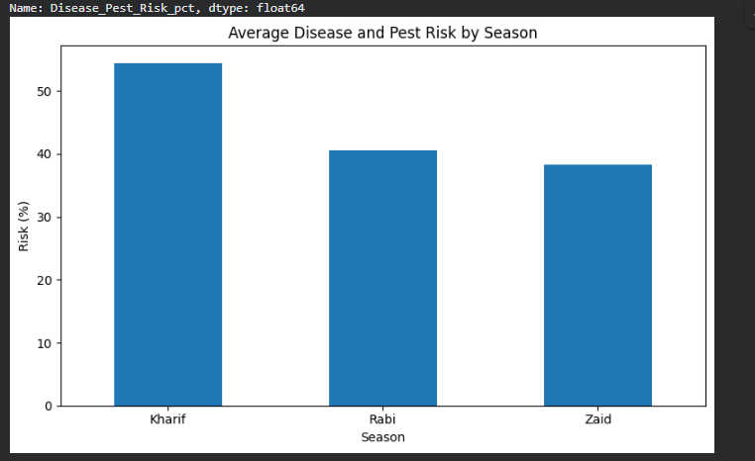
GRAPH 4

Slide 11
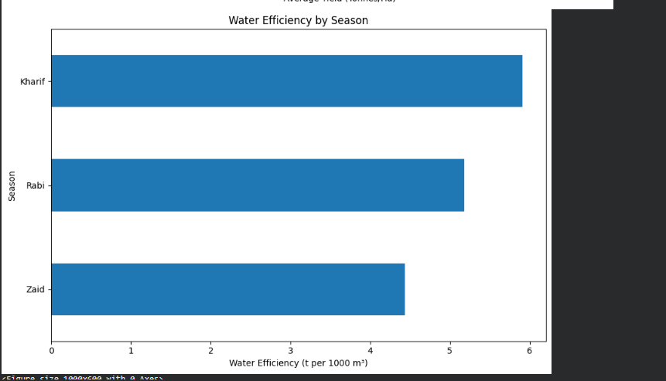
GRAPH 5

Slide 12
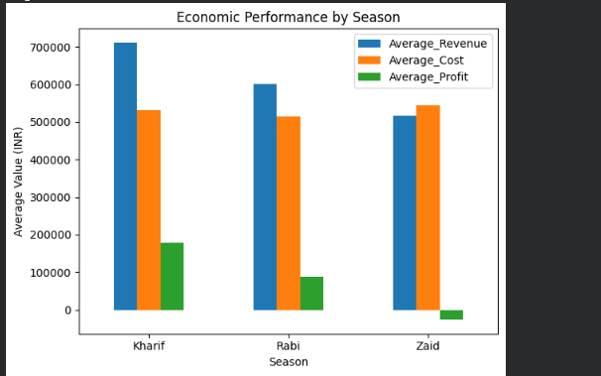
GRAPH 6

Slide 13
Future scope
Crop Yield Prediction – Use machine learning to predict future crop yields.
Weather Integration – Include real-time weather and rainfall data.
Advanced Regional Analysis – Compare agricultural performance across more regions.
Smart Resource Management – Optimize water, fertilizer, and pesticide usage.
Early Risk Detection – Predict disease and pest risks in advance.

Slide 14
GETHUB LINK
https://github.com/workyashu14-cyber/seasonal-agriculture-performance-analysis.git

Slide 15
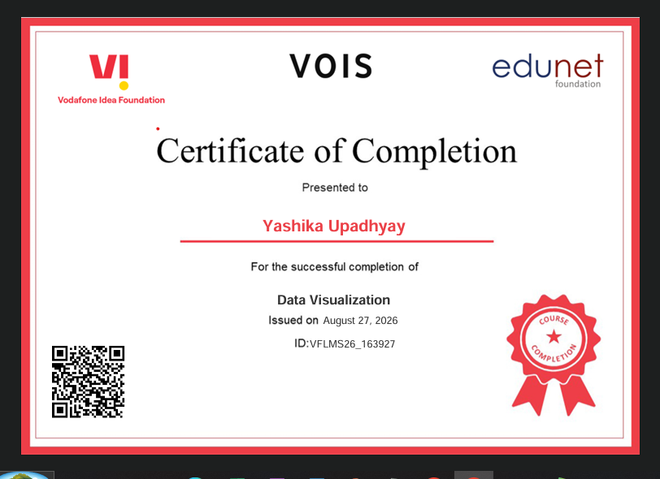
VOIS Course completion certificate - Course name- Data Visualization

Slide 16
THANK YOU

